Slide 1
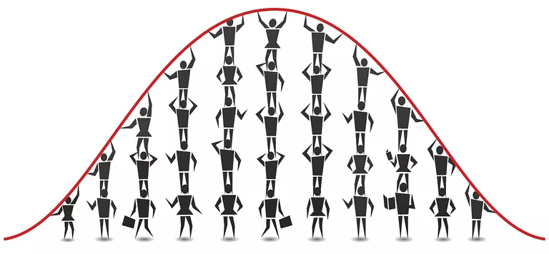
Tutorial 2 Statistics
Dr. Dvir Aran - Introduction to Bioinformatics (236523) Winter 2021
Almog Angel

Slide 2
Today we will talk about…
What is statistics?
Descriptive statistics
The central limit theorem (CTL)
Hypothesis testing
t-test
p-value
Class exercise
Notes:
*** Download the data from the course website
*** install ggplot2 and stringi packages

Slide 3


What is statistics?
A branch of mathematics dealing with the collection, analysis, interpretation, and presentation of data
The two major areas of statistics: descriptive and inferential
Descriptive statistics describes the properties of sample and population data
Inferential statistics uses those properties to test hypotheses and draw conclusions
Notes:
Descriptive – organize, summaries, simplify, describe and present the data
Inferential הסקתי – generalize from samples to populations, hypothesis testing, predictions

Slide 4


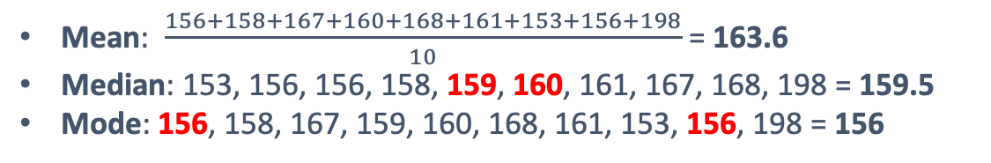
Descriptive statistics
How tall are humans?
156, 158, 167, 159, 160, 168, 161, 153, 156, 198 … (x8 billion)
Central tendency – the descriptive summary of a dataset through a single value that reflects the center of the data distribution
Mean: $\frac{156+158+167+160+168+161+153+156+198}{10}$ = 163.6
Median: 153, 156, 156, 158, 159, 160, 161, 167, 168, 198 = 159.5
Mode: 156, 158, 167, 159, 160, 168, 161, 153, 156, 198 = 156

Slide 5

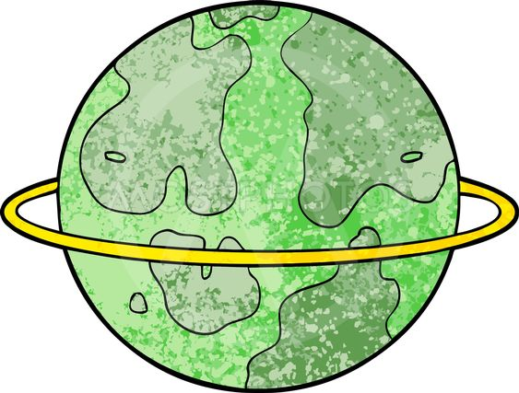
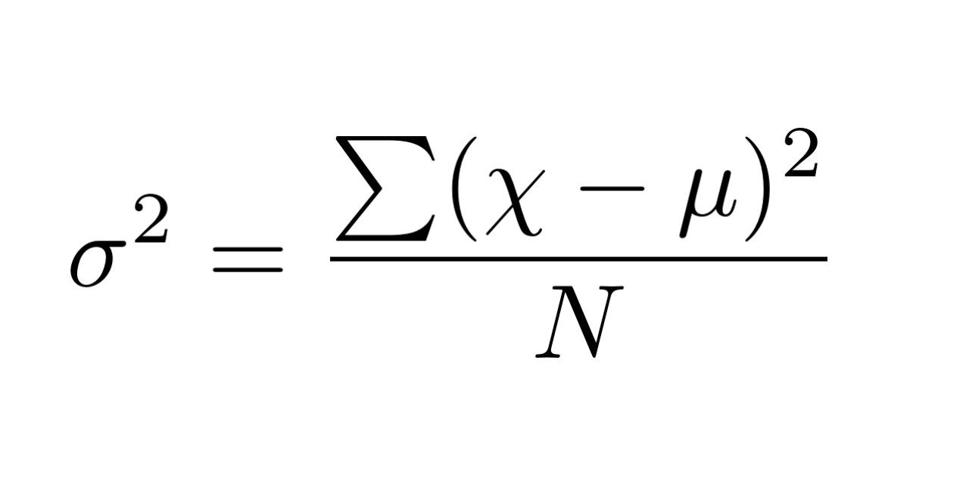
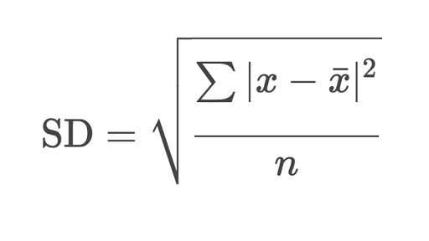
Descriptive statistics
𝞼 – population
S - sample
Mean = 163.6
Variance = 𝞼² = 168.26
SD = 𝞼 = 12.97176
156, 158, 167, 159, 160, 168, 161, 153, 156, 198
Mean = 163.6
Variance = 𝞼 ² = 523.82
SD = 𝞼 = 22.88716
133, 145, 142, 159, 160, 155, 160, 194, 200, 188
Variance – the average degree to which each value differs from the mean
Standard deviation – the square root of the variance
The standard deviation is expressed in the same units as the mean is, whereas the variance is expressed in squared units

Slide 6
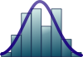
The central limit theorem (CTL)
Population
Population mean
Sample mean
Inferential
statistics
Sample mean
Sample mean
Sample
Short
Tall
Notes:
Population vs. sample
Not all distributions are normal
CLT - the distribution of sample means approximates a normal distribution as the sample size gets larger

Slide 7


X̄ = sample mean
μ = population mean
S = sample SD
S² = sample variance
Inferential statistics - hypothesis testing
Hypothesis testing is used to draw inferences about the overall data behavior performing statistical tests on a sample from the population
Sample (n=10)
X̄ = 174.8
S = 12.4
S² = 155.51
165, 173, 161, 177, 171, 194, 165, 178, 166, 198
Sample (n=10)
X̄ = 193
S = 12. 5
S² = 156
194, 188, 210, 186, 175, 198, 214, 197, 190, 178
Notes:
Decide on a hypothesis to test, often called the “null hypothesis” (H0). The null hypothesis assume that there is no anomaly in the tested population (ex. there is no difference between sets of samples).
Decide on the “alternative hypothesis” (H1). The alternative hypothesis that observation is due to real phenomena.
Decide on a statistic test that will test the truth of the null hypothesis.
Compare the result of the statistic test it to the observed value to establish significance, the P-value. Based on that, either reject or not reject the null hypothesis, H0.

Slide 8
Inferential statistics - hypothesis testing
1. Specify the Null Hypothesis
Null hypothesis (H₀): There is no difference in height between humans from soccer and basketball courts
2. Specify the Alternative Hypothesis
Alternative hypothesis (H₁): Humans from basketball courts are taller than human from soccer field (one side comparison)
Alternative hypothesis (H₁): There is a difference between heights of humans from soccer and basketball courts (two sides comparison)
3. Set the Significance Level
P-value is 0.05 (5%)
4. Calculate the Test Statistic and Corresponding P-Value
Find the right statistical test (next slide)
5. Drawing a Conclusion
H₀ : μ₁ = μ₂
H₁ : μ₁ > μ₂

Slide 9
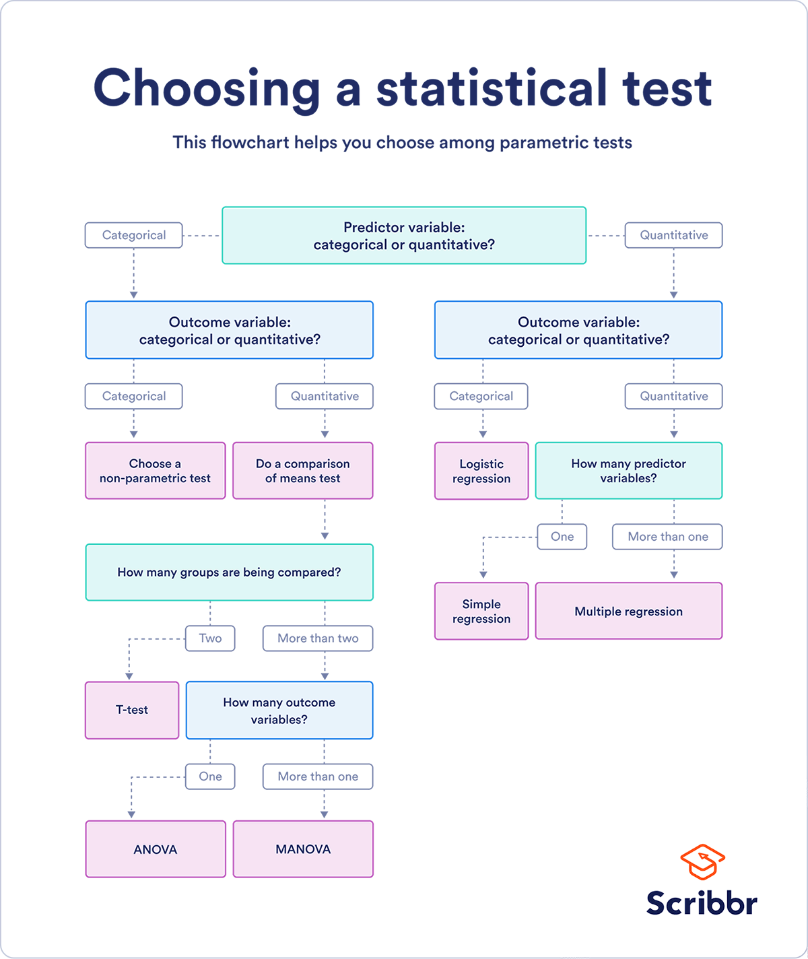
Inferential statistics - hypothesis testing
Notes:
Assumptions:
Independence of observations
Homogeneity of variance
Normality of data
Also notice:
Types of variables
Sample size

Slide 10
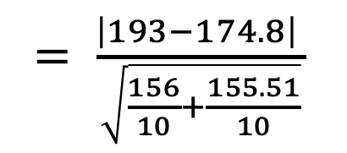
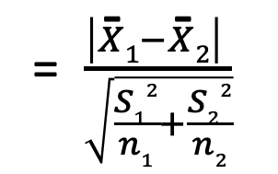
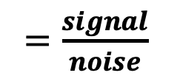
Student's t-test
Test how strong the difference (if there is) between two samples
$=\frac{signal}{noise}$
= $\frac{\left|X\text{̄}1−X\text{̄}2\right| }{\sqrt{\frac{S12}{n1}+\frac{S22}{n2}}}$
$= \frac{\left|193−174.8\right| }{\sqrt{\frac{156}{10}+\frac{155.51}{10}}}$
t-value
= 3.26
signal
X̄₂
X̄₁
noise
noise
noise
174.8
193

Slide 11
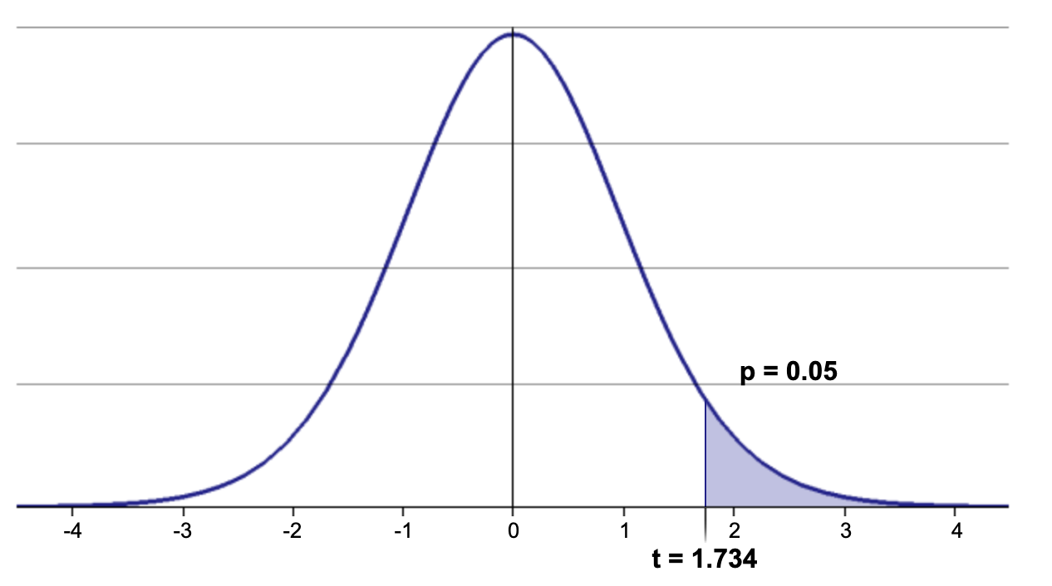
The t-distribution
The distribution of the probability to get each t-value
Degree of freedom (df) = n₁ + n₂ - 2 = 10 + 10 - 2 = 18
A critical value (p) that we set to answer the earlier
Probability
3.26
t-value
Our t-value 3.26 > 1.734, therefore we can reject the null hypothesis
Humans from a basketball court are significantly taller than humans from a soccer filed
http://www.statdistributions.com/t/?p=0.1&df=12&tail=2
Notes:
The degree of freedom determent the shape of the t-distribution curve as it approach the normal curve when n = 30

Slide 12
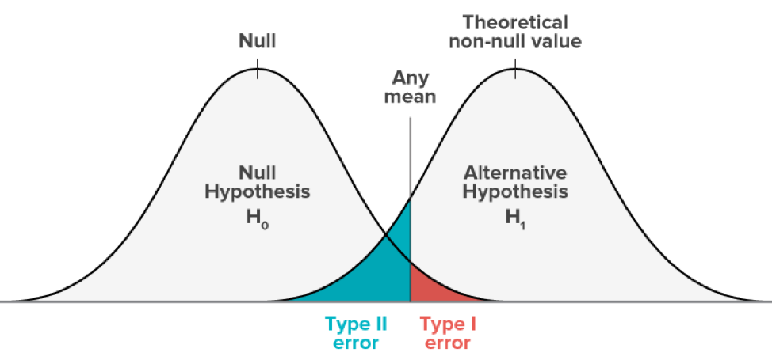
The p-value
A p-value is a measure of the probability that an observed difference could have occurred just by random chance
The lower the p-value, the greater the statistical significance of the observed difference
p-values just tell you how sure you can be with your results, they can still be misleading!
Type I error means rejecting the null hypothesis when it's actually true (false positive)
Type II error means accepting the null hypothesis when it's actually false (false negative)
Notes:
The degree of freedom determent the shape of the t-distribution curve as it approach the normal curve when n = 30

Slide 13

P-hacking
Notes:
Define and null and alternative hypothesis

Slide 14



Class exercise
The Israeli Corona Cabinet proposed the allocation of money for a campaign to convince people to get vaccinated
However, there is not enough money for a country-wide campaign
The minister of health argue that there are fewer vaccinated people in the periphery compared to the central region
As one of the top statisticians in the country, they ask you to analyze the data and suggest whether the campaign should be focus on the periphery or not.
Notes:
Define and null and alternative hypothesis

